Slide 1
TRADITIONAL VS AGILE METHODOLOGIES
BY,
MAHALAKSHMI K

Slide 2
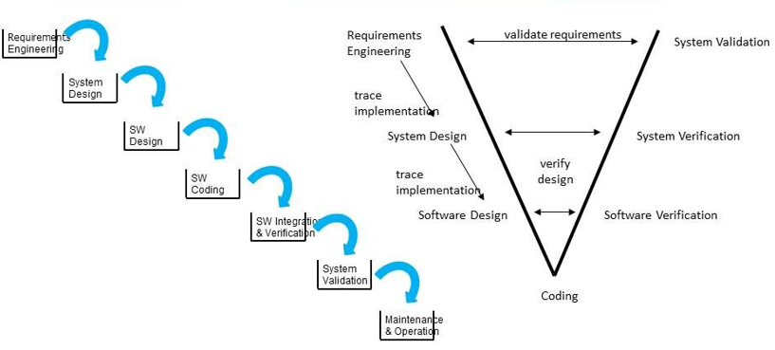
TRADITIONAL METHODOLOGIES
Step-by-step, sequential project execution.
Examples: Waterfall, V-Model, Spiral.
Focus on extensive planning and documentation.

Slide 3
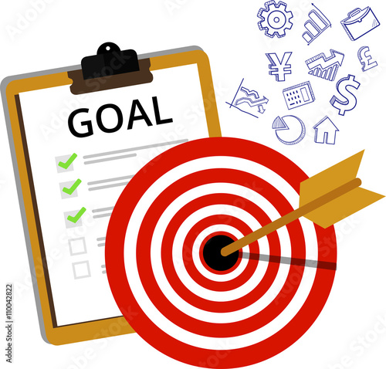
OBJECTIVE
Deliver a well-defined product as per requirements.
Minimize project risks by thorough upfront planning.
Ensure structured and predictable outcomes.

Slide 4
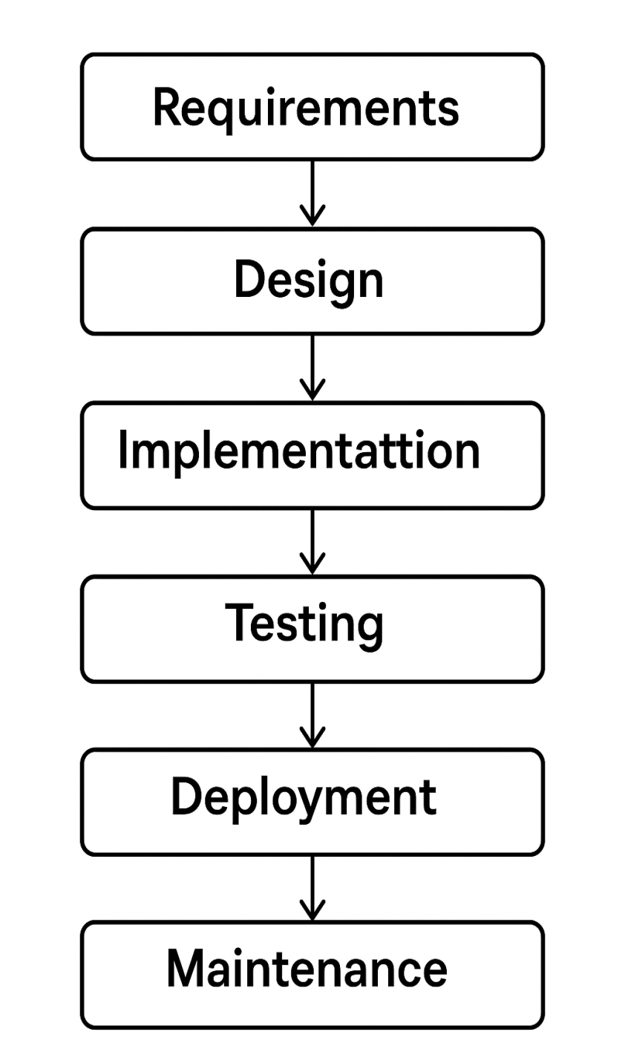
IMPLEMENTATION
Gather complete requirements at the start.
Follow strict, linear project phases: Design → Development → Testing → Deployment.
Review only after major phase completion.

Slide 5
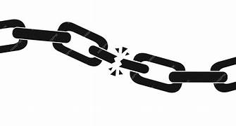
DRAWBACKS
Difficult to adapt to changes after project starts.
Late discovery of issues or mismatches with needs.
High risk if requirements are misunderstood initially.

Slide 6
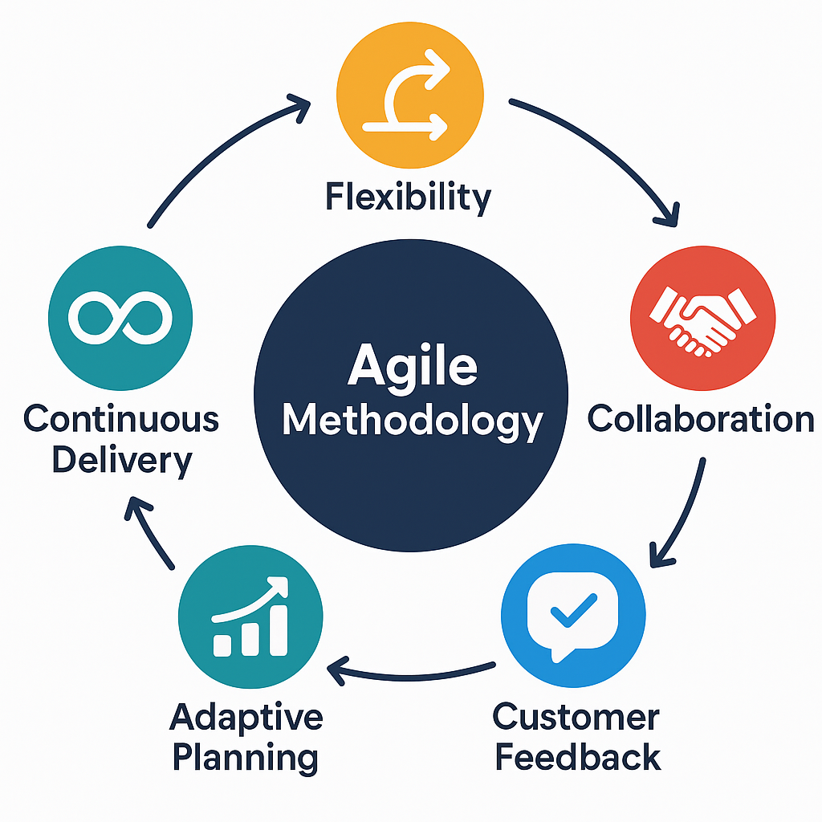
AGILE METHODOLOGIES
Focus on flexibility, collaboration, and customer feedback.
Examples: Agile, Scrum, Lean.
Emphasizes adaptive planning and continuous delivery.

Slide 7
OBJECTIVE
Deliver value to customers faster and more efficiently.
Embrace changes anytime during the project.
Improve team collaboration and transparency.

Slide 8
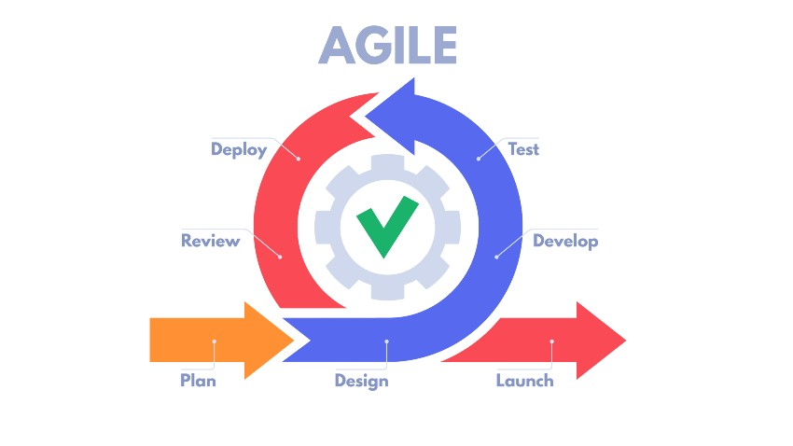
AGILE WORKFLOW
Work in short cycles (sprints or iterations).
Continuously plan, build, test, and review.
Involve customer feedback at every stage.

Slide 9
HOW IT OVERCOMES DRAWBACKS OF TRADITIONAL METHODOLOGIES
Allows real-time changes based on feedback.
Early and continuous testing catches issues quickly.
Reduces risks through incremental delivery.

